Slide 1
Pattern matching
Algorithms used for pattern matching
Inflexible pattern search algorithms
Karp-Rabin algorithm
KMP algorithm
Boyer-Moore algorithm

Slide 2
Inflexible algorithm (Brute Force)
Operates in a way of comparing characters within patterns one by one while patrolling the body strings from the beginning to the end in order.
t
T | T | T | T | A | A | C | C | A | …
Failure
p
T | T | A | T | T | T | C | T | A | …
Move one column, compare
t
T | T | T | T | A | A | C | C | A | …
Failure
p
T | T | A | T | T | T | C | T | A | …

Slide 3
Algorithm explanation
t
T | T | T | T | A | A | C | C | A | …
index i
p
T | T | A | T | T | T | C | T | A | …
index j
t
T | T | T | T | A | A | C | C | A | …
index i
p
T | T | A | T | T | T | C | T | A | …
index j

Slide 4
t
T | T | T | T | A | A | C | C | A | …
index i
p
T | T | A | T | T | T | C | T | A | …
index j
Failure
Inefficient!!!!!!
t
T | T | T | T | A | A | C | C | A | …
index i
Move to the next starting point
p
T | T | A | T | T | T | C | T | A | …
index j
Return to the starting point

Slide 5
BRUTEFORCE
TEXT
0 | 1 | 2 | 3 | 4 | 5 | 6 | 7 | 8 | 9 | 10 | 11 | 12 | 13 | 14
G | C | G | C | T | T | A | A | C | G | C | T | A | G | T
PATTERN
G | C | T | A | G

Slide 6
TEXT
i
0 | 1 | 2 | 3 | 4 | 5 | 6 | 7 | 8 | 9 | 10 | 11 | 12 | 13 | 14
G | C | G | C | T | T | A | A | C | G | C | T | A | G | T
PATTERN
G | C | T | A | G
J = 3
i = i – j + 1;
J = 0

Slide 7
Inflexible pattern search algorithm
// p[] : pattern to search
// t[] : the entire text
// M : length of the pattern to search;
// N : length of the entire text;
// i : index of t
BruteForce(p[], t[])
i ← 0, j ← 0
while(j < M and i < N) do {
if (t[i] ≠ p[j]) then {
i ← i - j;
j ← -1;
}
i ← i + 1, j ← j + 1
}
if (j = M) then return i - M;
else return i;
end ButeForce()

Slide 8
Time complexity of inflexible pattern search algorithm
In worst case scenario, the time complexity becomes O(MN) because it has to compare patterns from all aspects of text.
In the example, 10,000*80 = 800,000 comparisons occur in worst case scenario.
Is there any way to decrease the number of comparisons?

Slide 9
Karp Rabin Algorithm
HASH FUNCTION
Compare the hash value of the pattern with the hash value of the pattern's length in text.
Worst Case : O(MN)
on averageLinear Time

Slide 10
Karp Rabin Algorithm
TEXT
6 | 8 | 4 | 3 | 2 | 1 | 2 | 4 | 3 | 1
PATTERN
4 | 3 | 2 | 1
The hash value of the PATTERN : 4321

Slide 11
Karp Rabin Algorithm
TEXT
6 | 8 | 4 | 3 | 2 | 1 | 2 | 4 | 3 | 1
The hash value of the selected characters : 6843
PATTERN
4 | 3 | 2 | 1
The hash value of the PATTERN : 4321

Slide 12
Karp Rabin Algorithm
TEXT
6 | 8 | 4 | 3 | 2 | 1 | 2 | 4 | 3 | 1
6 | 8 | 4 | 3 | 2 | 1 | 2 | 4 | 3 | 1
PATTERN
4 | 3 | 2 | 1
The hash value of the PATTERN : 4321

Slide 13

Karp Rabin Algorithm
TEXT
6 | 8 | 4 | 3 | 2 | 1 | 2 | 4 | 3 | 1
6 | 8 | 4 | 3
6 | 8 | 4 | 3
2

Slide 14
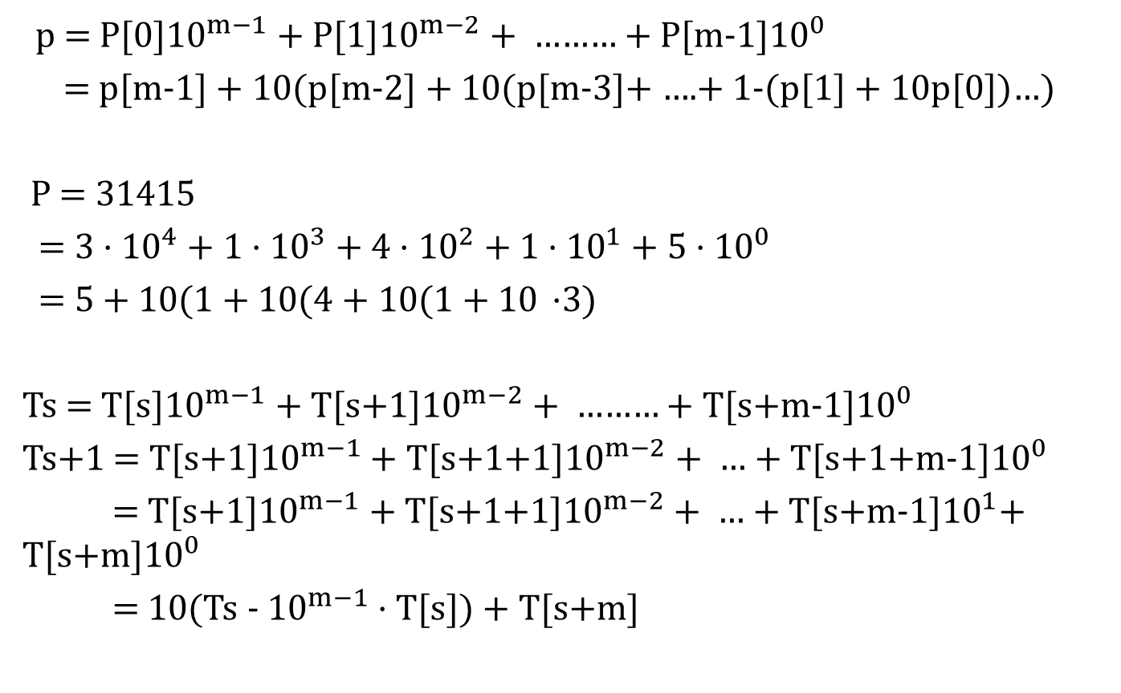
Rabin-Karp Algorithm
p = P[0]${10}^{m−1}$ + P[1]${10}^{m−2}$ + ……… + P[m-1]${10}^{0}$
= p[m-1] + 10(p[m-2] + 10(p[m-3]+ ….+ 1-(p[1] + 10p[0])…)
P = 31415
= 3 · ${10}^{4}$ + 1$\text{·} {10}^{3}$ + 4$\text{·} {10}^{2}$ + 1$\text{·} {10}^{1}$ + 5$\text{·} {10}^{0}$
= 5 + 10(1 + 10(4 + 10(1 + 10 $\text{·}$3)
Ts = T[s]${10}^{m−1}$ + T[s+1]${10}^{m−2}$ + ……… + T[s+m-1]${10}^{0}$
Ts+1 = T[s+1]${10}^{m−1}$ + T[s+1+1]${10}^{m−2}$ + … + T[s+1+m-1]${10}^{0}$
= T[s+1]${10}^{m−1}$ + T[s+1+1]${10}^{m−2}$ + … + T[s+m-1]${10}^{1}$+ T[s+m]${10}^{0}$
= 10(Ts -${10}^{m−1}$ · T[s]) + T[s+m]

Slide 15

Rabin-Karp Algorithm
23495 =
31415 mod 13

Slide 16
Rabin-Karp Algorithm
Rabin-Karp Algorithm using mod 13
3 1 4 1 5 2 3
3 1 4 1 5 2 3
3 1 4 1 5 2 3

